Slide 1

House Prices:
Advanced Regression Techniques
Data Bang Theory
Lei Han, Jinxin Hou, Siyuan Luo, Yutian Luo, Xiaoyou Zhou, Zhonghao Li
Notes:
Hayley

Slide 2
1
INTRODUCTION
2
EXPLORATORY DATA ANALYSIS
3
DATA PREPARATION
CONTENTS
4
FEATURE ENGINEERING
5
MODELS
6
RESULTS
Notes:
Hayley

Slide 3
Ask a home buyer to describe their dream house, and they will probably come up with many criterias, based on which, we want to help the home buyers to predict their dream house price.
Background:
01
Dataset:
Source: Kaggle. com
Content:
1 response variable (sales price)
79 explanatory variables describing residential homes in Ames, Iowa.
Goal: To predict the final price of each home.
INTRODUCTION
Notes:
Hayley

Slide 4
Sale Price Distribution
Correlations
Overall Quality to Sale Price
Year Built to Sale Price
02
EDA
Notes:
Hayley

Slide 5
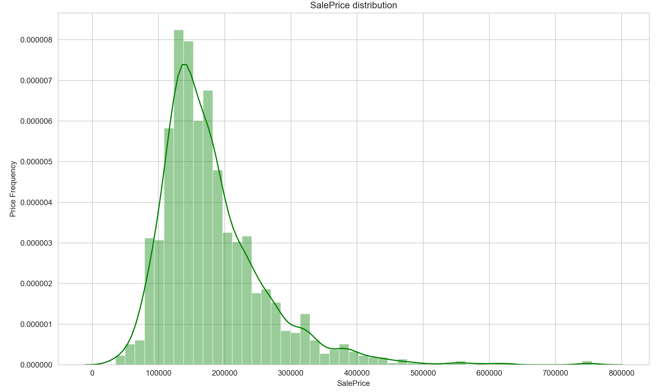
Sale Price Distribution
Right Skewed Distribution
Notes:
Jin
First, we would like to see how our label distributed, the sales price of all house prices.
From this histogram, we can see that the house price distribution is right skewed, which is common in our real life. since the majority of the society is middle class. Now we can use the label for our prediction confidently! However, since most prediction models can not trained really well on skewed distribution, we will fix the skewness. Then we will focus on the relationships between features and sale price.

Slide 6
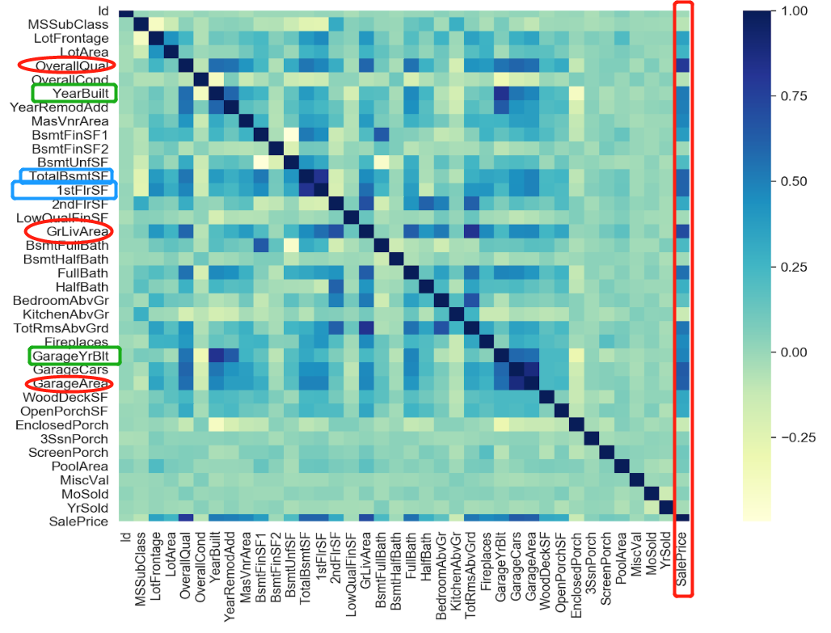
Correlations
Features vital to prediction:
"Overall Quallity"
“Ground living Area”
"Garage Area"
Similar features caused collinearility:
"GarageYrBlt" and "YearBuilt"
"TotalBsmtSF" and "1stFlrSF"
Notes:
Jin
In this case, heatmap will be really helpful! we make a heatmap for all the features and label against each other. And use the color to indicate the status of their correlations. The deeper the blue, the higher the correlation.
first, we focus on the last column, the relationships between all the features and saleprice. We can spot some features are highly correlated with saleprice! such as overall quality, ground living area, and garage area. So we will pay more attention to these features!
Moreover, we also want to evict some useless feature, such as the ones that will render multicollinearity.
For example,"GarageCars" and "GarageArea" , "TotalBsmtSF" and "1stFlrSF" are also highly correlated. \
#Therefore, when building our model, we will delete one feature of each pair.
After analyzing this heat map, we will dive into the specific relationships between important features and sale price based on the heat map, such as how the overall quality of the house and the year ...

Slide 7
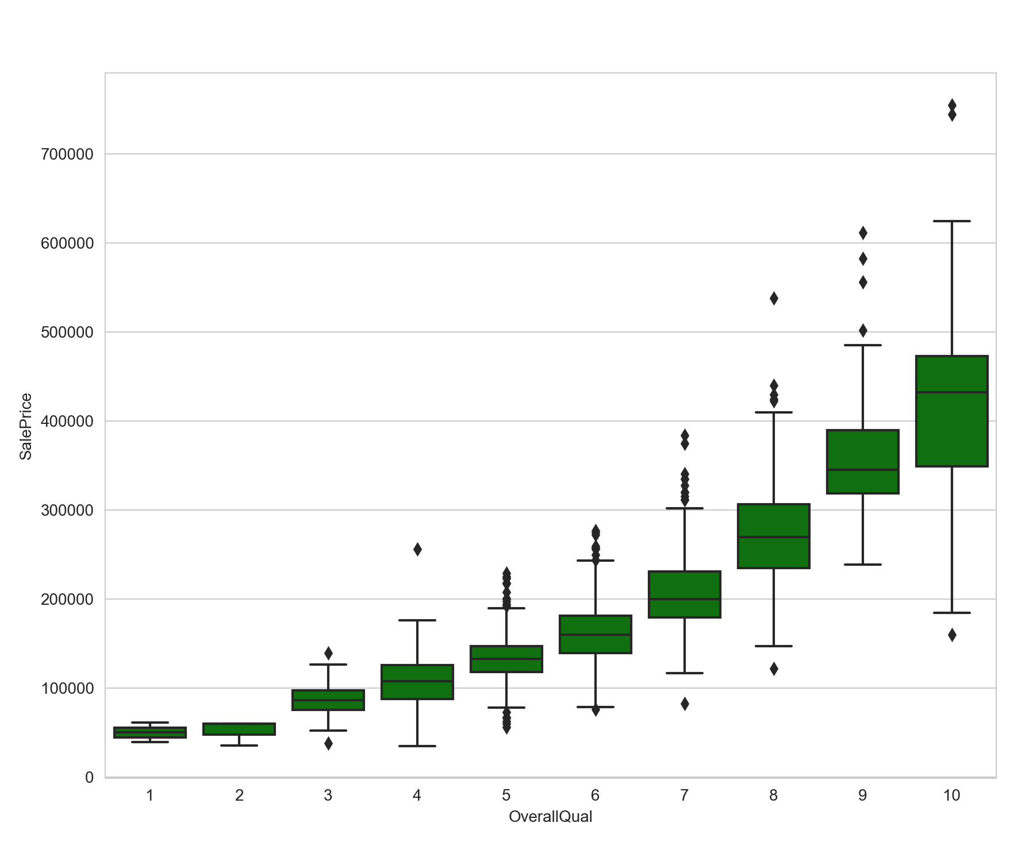
Overall Quality to Sale Price
When the overall quality increased
Sale price will increase;
Range of sale price will increase;
Almost all outliers are upward anomalies
Notes:
Yutian
For the plot of overall quality to sale price we find that when the overall quality increased, the sale price itself and its range will increase at same time. Interestingly, almost all outliers are upward anomalies, indicating that most alternatives not following the mainstream are high prices, not the floor price. The sell side is the dominant side in real estate market.

Slide 8
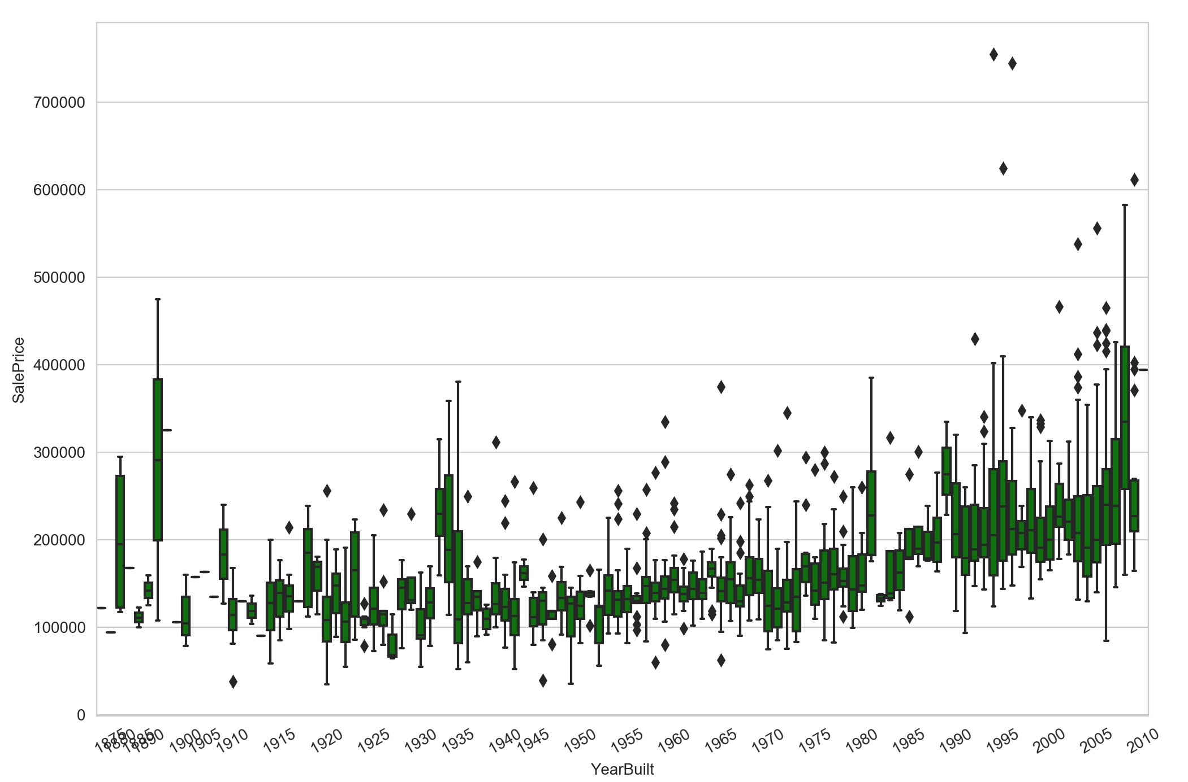
Year Built to Sale Price
Sale price increased stablely over years.
Some old houses might have higher value.
Turning Points (increase):
1950- first industry boom
1972- second industry boom
1993- third industry boom
Turning Points (decrease):
1923 to 1926 - real estate speculation frenzy
1981- first economic crisis
2008- subprime mortgage crisis
Notes:
Yutian
The forth plot show the relation between year built and sale price: the sale price is increasing stably over years. However, some old houses with historical value might have higher price.
Also, there are 3 points of turning to increase:
a. 1950 was the midpoint of the first industry boom after the end of World War II, where single-family home construction reached a record high.
b. 1972 was the midpoint of the second industry boom, where multi-family houses showed rapid growth, and the number of newly started houses reached a historical peak.
c. 1993 was the third industry boom, single-family residential sales grew rapidly again.
For 3 points of turning to decrease:
a. From 1923 to 1926, the real estate speculation frenzy started in Florida caused the Wall Street stock market to collapse, real estate prices decreased dramatically.
b. In the 1980s, the world's first economic crisis broke out, unemployment rate in US increased dramatically. People are full of negative attitudes towards the market and the number of real estate transactions had shrunk dramatically.
c. In 2008, the subprime mortgage crisis broke out, more and more people could no longer afford housing loans. They had to sell their houses at a low price or sell them with lower price after being recovered by banks.

Slide 9
Data Transformation
Data Cleaning
Data Normalization
03
DATA PREPARATION
Notes:
for data preparation, we basically focused on 3 parts:

Slide 10
#Example codes:
# change data types of each column to proper ones
# some of the non-numeric predictors are stored as numbers- convert into strings
all_features['GarageYrBlt'] = all_features['GarageYrBlt'].astype(str)
# fill the null values in numerical variables
all_features['MSZoning']=all_features['MSZoning'].fillna(all_features['MSZoning'].mode()[0])
all_features['LotFrontage']=all_features['LotFrontage'].fillna(all_features['LotFrontage'].mean())
# fill the null values in categorical variables
# data description states NA in “functional” column refers to typical(‘Typ’)values
all_features['Functional'] = all_features['Functional'].fillna('Typ')
# make dummies for categorical variables
all_features = pd.get_dummies(all_features).reset_index(drop=True)
# normalize all numeric features using min-max scale
all_features[numeric_cols]=all_features[numeric_cols].apply(lambdax:(x-x.min())/(x.max()-x.min()))
# transform “sales price” by log(1+x)
train["SalePrice_norm"] = np.log1p(train["SalePrice"])
Notes:
here i gave some example codes to give u guys a better idea about what we have done for data preparation.
in terms of Data Transformation- checked all the data type of each column and converted the data type of some columns to the right ones for further prediction
in terms of Data Cleaning
checked the missing condition of each value,and dropped unnecessary features which have more than 90% null values
fill the NAs in numerical features with mode or mean based on the data or fill the NAs with 0 if the values don't exist
fill the NAs in categorical features with reasonable values according to the data description or fill them with “don’t exsit”; then we made dummies for categorical variables to numerically encode categorical features because most models can only handle numerical features.
in terms of Data Normalization
- Get rid of any duplicate data that might appear within the data set.
- Normalized all numeric features using min-max scale
- Log the sales price so that the result won’t be affected by the skewness in the price

Slide 11
Feature engineering
Overall condition
-Total square feet
-Number of bathroom
Remodel condition
-Time span
Utility
-Swimming pool
-Garage
-Basement
04
FEATURE ENGINEERING
Notes:
# Based on the overall quality to sale price, we have several findings:
# 1. when the overall quality increased, the sale price will increase;
# 2. when the overall quality increased, the range of sale price will increase as well;
# 3. almost all outliers are upward anomalies (above the upper bound),
# indicating that all alternatives that are not following the mainstream are high prices,
# not the floor price. The sale side is the dominant side in real estate sale industry.

Slide 12
XGBoost Model
Ridge Model
Random Forest Model
05
MODELS
Notes:
xgboost used a more regularized model formalization to control over-fitting, which gives it better performance. Performed best among kaggle competitions.
One important advantage of the ridge regression is that it still performs well when you have a large multivariate data.
Random Forest Model offers efficient estimates of the test error without incurring the cost of repeated model training associated with cross-validation

Slide 13
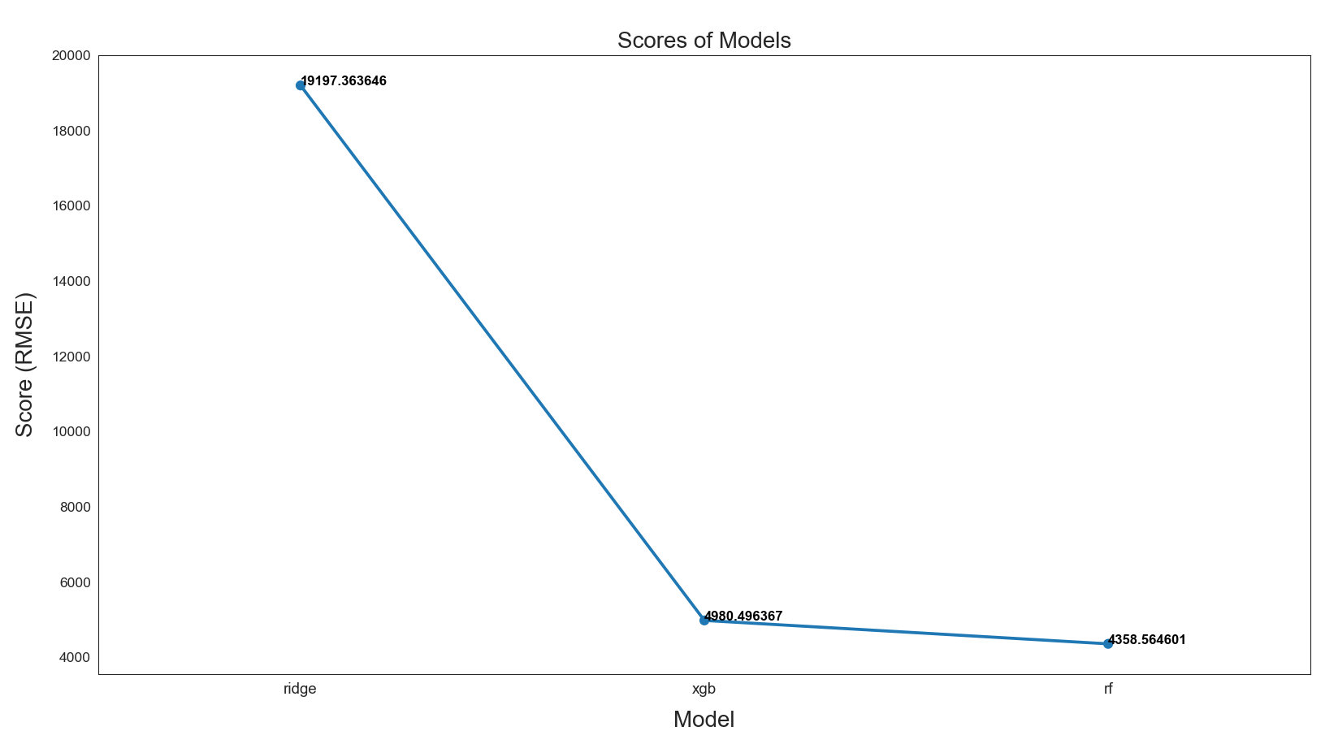
Model Performance
Random Forest Model performs the best

Slide 14
The evaluate metric decreased by approximately 2000 (RMSE) on our best model after we finalized feature engineering.
XGBoost outperformed all alone compared to Ridge and Random Forest model with our dataset.
06
RESULTS

Slide 15
Thank You!

